Slide 1
Chapter 0:
Introduction

Slide 2
Chapter 0: Introduction
0.1 The Role of Algorithms
0.2 The Origins of Computing Machines
0.3 The Science of Algorithms
0.4 Abstraction
0.5 An Outline of Our Study
0.6 Social Repercussions

Slide 3
Terminology
Algorithm: A set of steps that defines how a task is performed
Program: A representation of an algorithm
Programming: The process of developing a program
Software: Programs and algorithms
Hardware: Equipment

Slide 4
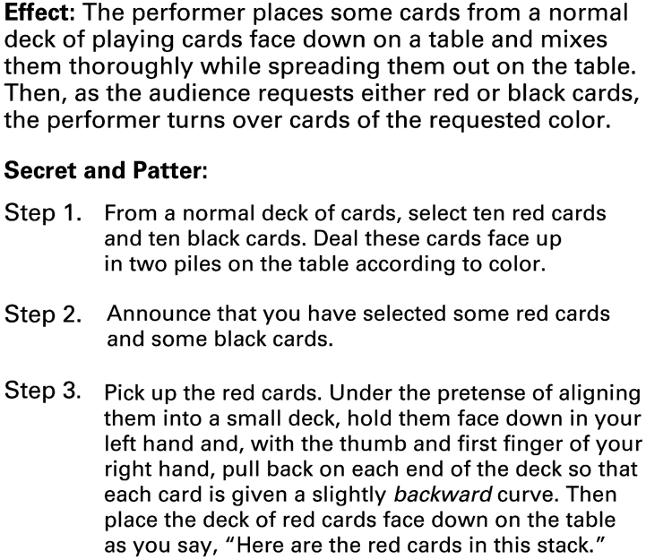
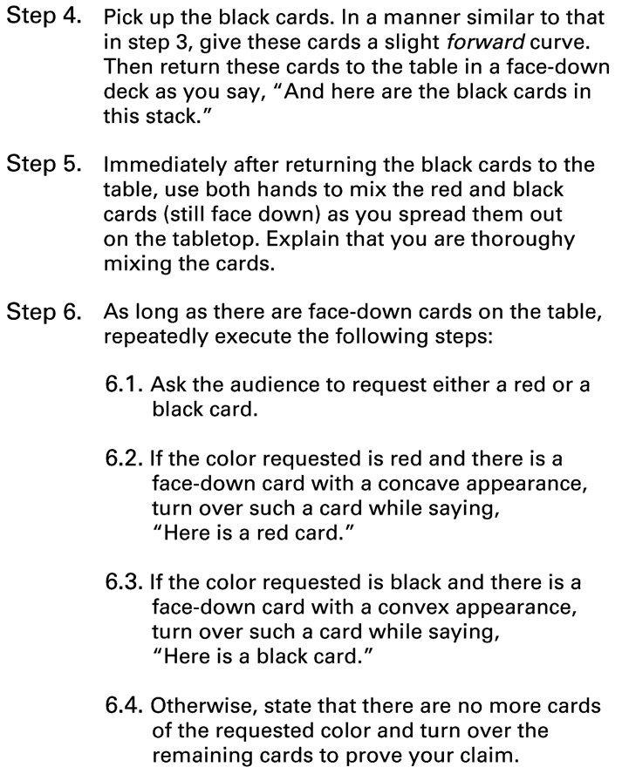
Figure 0.1 An algorithm for a magic trick

Slide 5
History of Algorithms
The study of algorithms was originally a subject in mathematics.
Early examples of algorithms
  Long division algorithm
  Euclidean Algorithm
Gödel's Incompleteness Theorem: Some problems cannot be solved by algorithms.

Slide 6
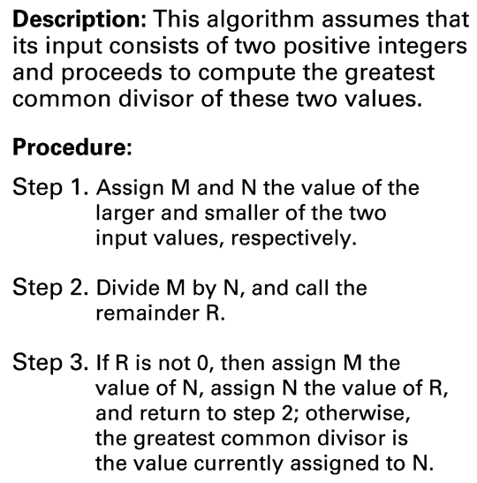
Figure 0.2 The Euclidean algorithm

Slide 7
Origins of Computing Machines
Early computing devices
  Abacus: positions of beads represent numbers
  Gear-based machines (1600s-1800s)
    Positions of gears represent numbers
    Blaise Pascal, Wilhelm Leibniz, Charles Babbage

Slide 8
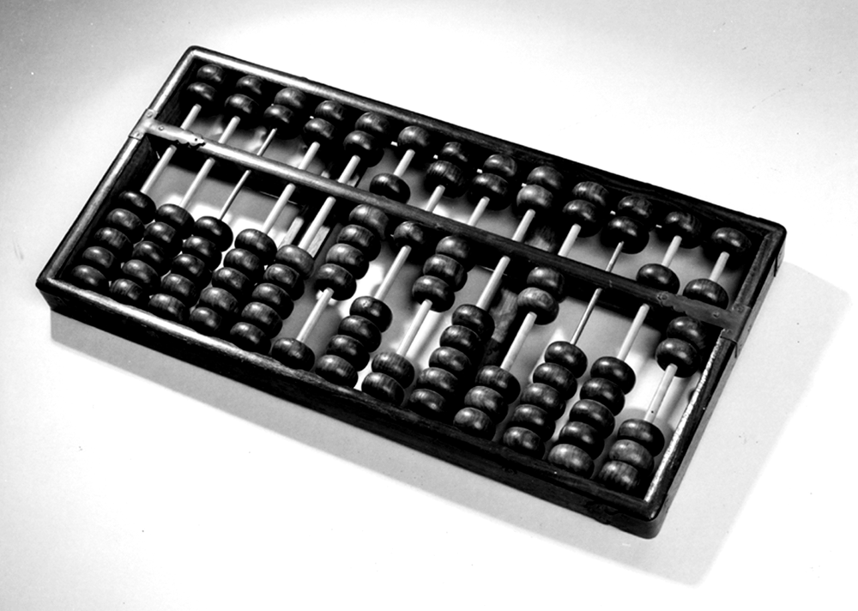
Figure 0.3 An Abacus

Slide 9
Early Data Storage
Punched cards
  First used in Jacquard Loom (1801) to store patterns for weaving cloth
  Storage of programs in Babbage’s Analytical Engine
  Popular through the 1970’s
Gear positions

Slide 10
Early Computers
Based on mechanical relays
  1940: Stibitz at Bell Laboratories
  1944: Mark I: Howard Aiken and IBM at Harvard
Based on vacuum tubes
  1937-1941: Atanasoff-Berry at Iowa State
  1940s: Colossus: secret German code-breaker
  1940s: ENIAC: Mauchly & Eckert at U. of Penn.

Slide 11
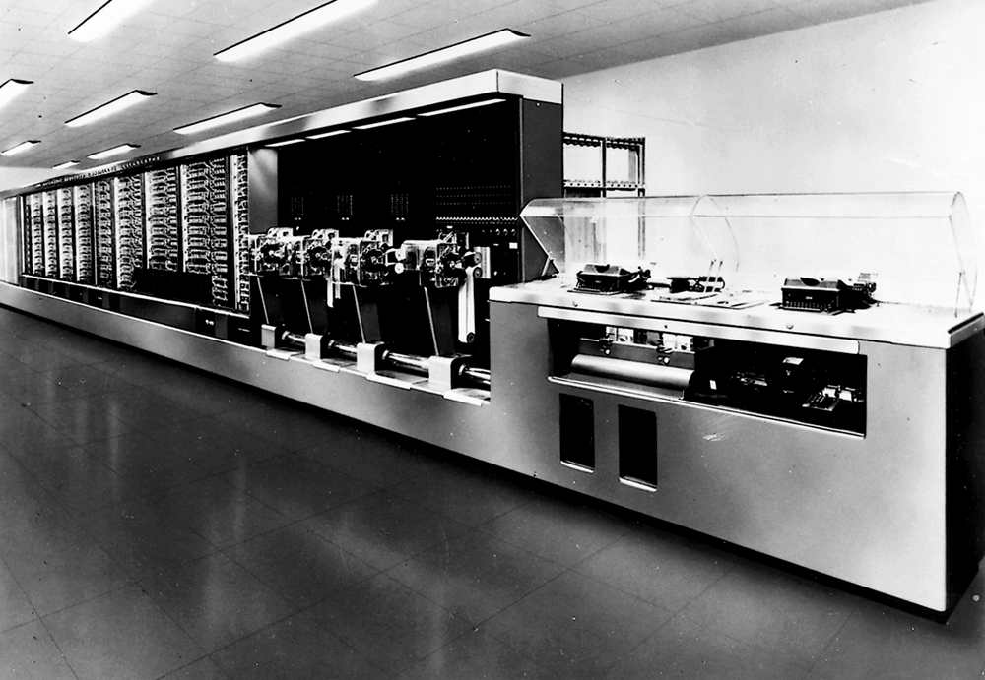
Figure 0.4 The Mark I computer

Slide 12
Personal Computers
  First used by hobbyists
  IBM introduced the PC in 1981.
    Accepted by business
    Became the standard hardware design for most desktop computers
    Most PCs use software from Microsoft

Slide 13
Computer Science
The science of algorithms
Draws from other subjects, including
  Mathematics
  Engineering
  Psychology
  Business Administration
  Psychology

Slide 14
Central Questions of Computer Science
Which problems can be solved by algorithmic processes?
How can algorithm discovery be made easier?
How can techniques of representing and communicating algorithms be improved?
How can characteristics of different algorithms be analyzed and compared?

Slide 15
Central Questions of Computer Science (continued)
How can algorithms be used to manipulate information?
How can algorithms be applied to produce intelligent behavior?
How does the application of algorithms affect society?

Slide 16
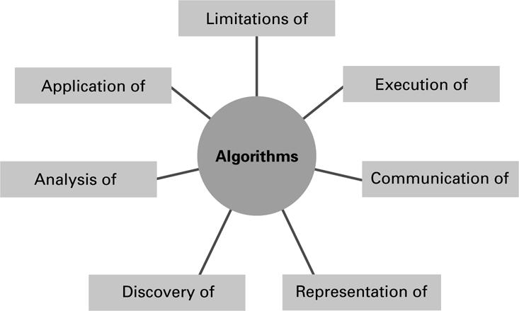
Figure 0.5 The central role of algorithms in computer science

Slide 17
Abstraction
Abstraction: The distinction between the external properties of an entity and the details of the entity’s internal composition
Abstract tool: A “component” that can be used without concern for the component’s internal properties

Slide 18
Outline of Our Study
Chapter 1: Data Storage
Chapter 2: Data Manipulation
Chapter 3: Operating Systems
Chapter 4: Networks and the Internet
Chapter 5: Algorithms
Chapter 6: Programming Languages

Slide 19
Outline of Our Study (continued)
Chapter 7: Software Engineering
Chapter 8: Data Abstractions
Chapter 9: Database Systems
Chapter 10: Computer Graphics
Chapter 11: Artificial Intelligence
Chapter 12: Theory of Computation

Slide 20
Social Repercussions
Advances in computer science raise new questions.
  In law: Questions of rights and liabilities
  In government: Questions of regulation
  In the work place: Questions of professionalism
  In society: Questions of social behavior

Slide 21
Ethical Theories
Consequence based:
What leads to the greatest benefit?
Duty based:
What are my intrinsic obligations?
Contract based:
What contracts must I honor?
Character based:
Who do I want to be?

